Slide 1
A&S 25-2
If you have any questions on the rules or information below contact A&S Phase I Staff
Candidates are authorized to arrive NET 30 March 2025 @1800 and NLT 31 March 2025 @ 0600.
Accountability formation will be held on 31 March 2024 at 0830 outside the Stone Bay RR-2 barracks. In the event of inclement weather, candidates will be standing by their racks in RR-2 at 0830.
Candidates who are missing luggage must immediately report issue to the staff instructor during the first formation
Candidates are encouraged not to consume alcohol.
Alcohol is prohibited in the barracks.
Any alcohol related incident or being found not fit for duty will result in dismissal from A&S.
Candidates are permitted to PT within the authorized areas from sunrise to sunset (map posted on whiteboard inside RR-2). Candidates are recommended to PT during this period and can utilize the last week of the MARSOC 10 Week Prep Guide or the last week of your personal training program.
Candidates are encouraged to pack, shaving kit, utilities, boots, cover, gym shoes and green on green PT as part of carry-on luggage.
You must complete Cyber Awareness training (CYBERM0000) on MarineNet, if not completed prior to arrival. Print a copy of your certificate and bring it to the official check-in.
Candidates are not required to wear uniforms; you are authorized to wear appropriate civilian attire. All customs, courtesies, orders, and regulations apply to all candidates.
Stone Bay Dining Facility hours:
Monday through Friday
Breakfast 0530-0800
Lunch 1100-1300
Dinner 1600-1800
Saturday and Sunday
Breakfast 0630-0800
Lunch 1130-1300
Dinner 1630-1800
Stone Bay MCX hours:
Monday Through Friday 0500-1800
Saturday 0900-1600
Sunday Closed
This is your opportunity to recover from travel, ensure you have all required items on the gear list and to adjust to the time zone / climate.
Change made: 21 January 2025

Slide 2
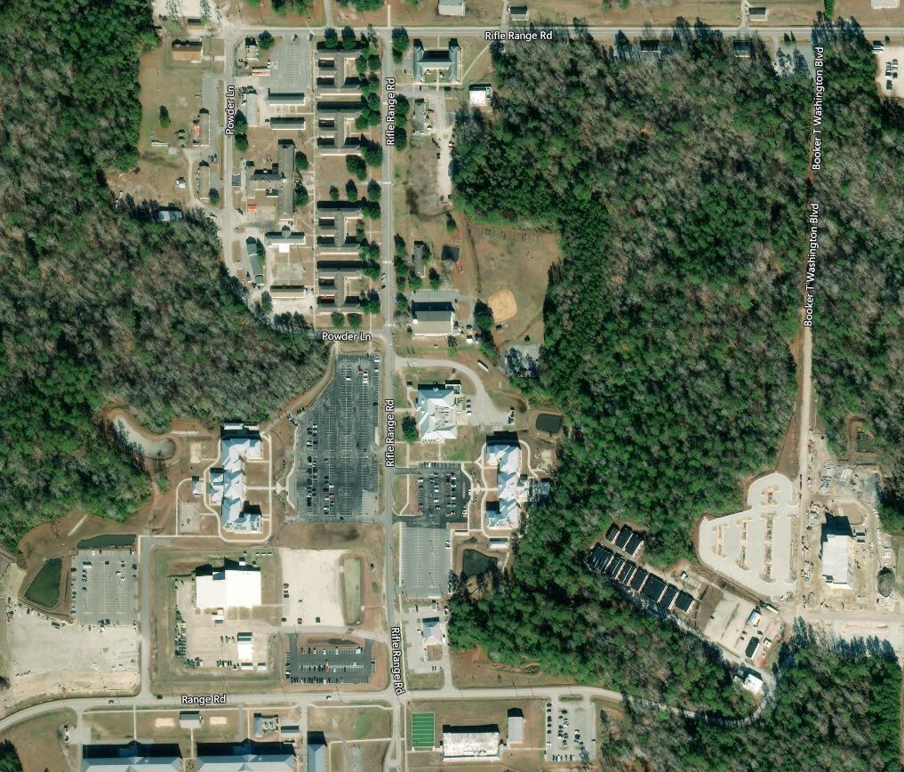
The route highlighted in BLUE (1.5 miles),the PT field (highlighted in GREEN) and all roads are authorized for physical training.
AUTHORIZED PHYSICAL TRAINING AREAS
N
LRC
RR2
PT Field
GYM

Slide 3
MARINE RAIDER TRAINING CENTER
ASSESSMENT AND SELECTION
Points of Contact
Any questions will be directed to the below POC’s. Beginning with the Phase I Primary Instructor, if unable to reach POC, continuing calling the POC’s listed below the Phase I POC’s.
Emergencies call 911
A&S Phase I Primary Instructor / Assistant Instructor
Office: (910) 440-0237
Duty: (910) 741-9964
Cell: (910) 787-3391
A&S SNCOIC
Office: (910) 440-1345
Cell: (910) 431-4114
A&S Operations Chief
Office: (910)-440-2513
Cell: (910)-742-7296
MRTC CDO
Office: (910) 440-2727
MRTC Medical front desk
(910) 440-0219

